Slide 1

Lung Cancer Campaign
April 14, 2015

Slide 2

HealthyDelaware.org/Lung

Slide 3
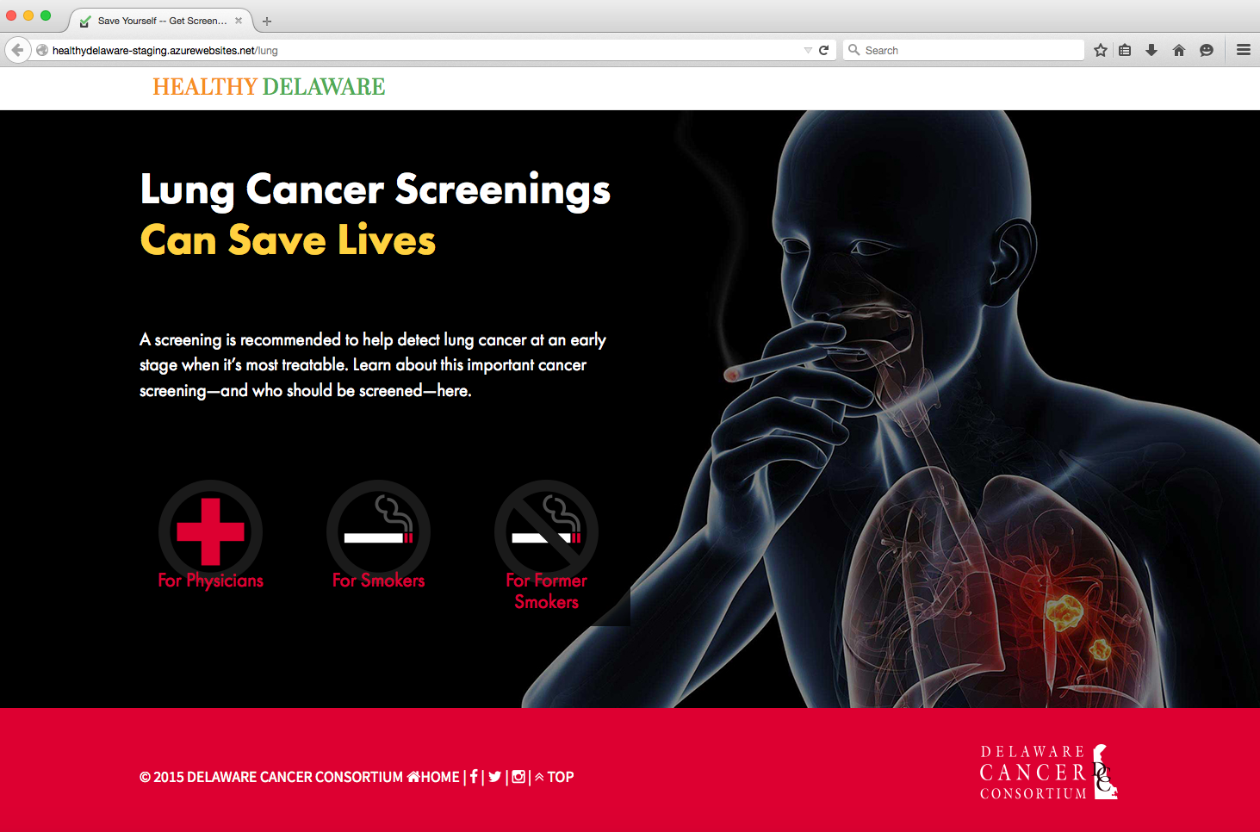

Slide 4
HealthyDelaware.org/Lung

Slide 5

Health Care Provider Campaign Components

Slide 6
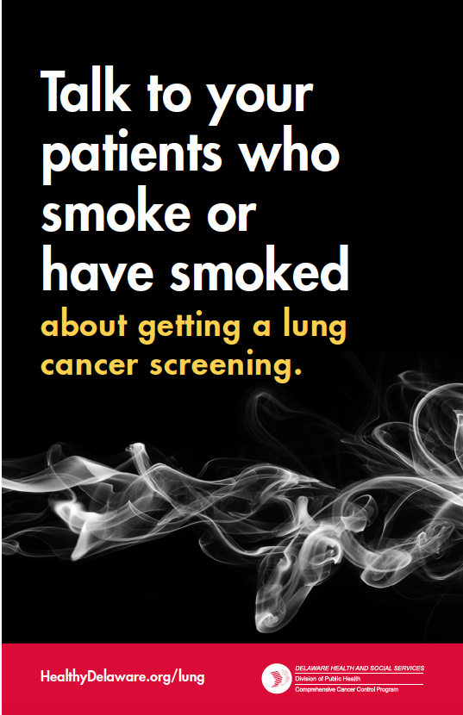
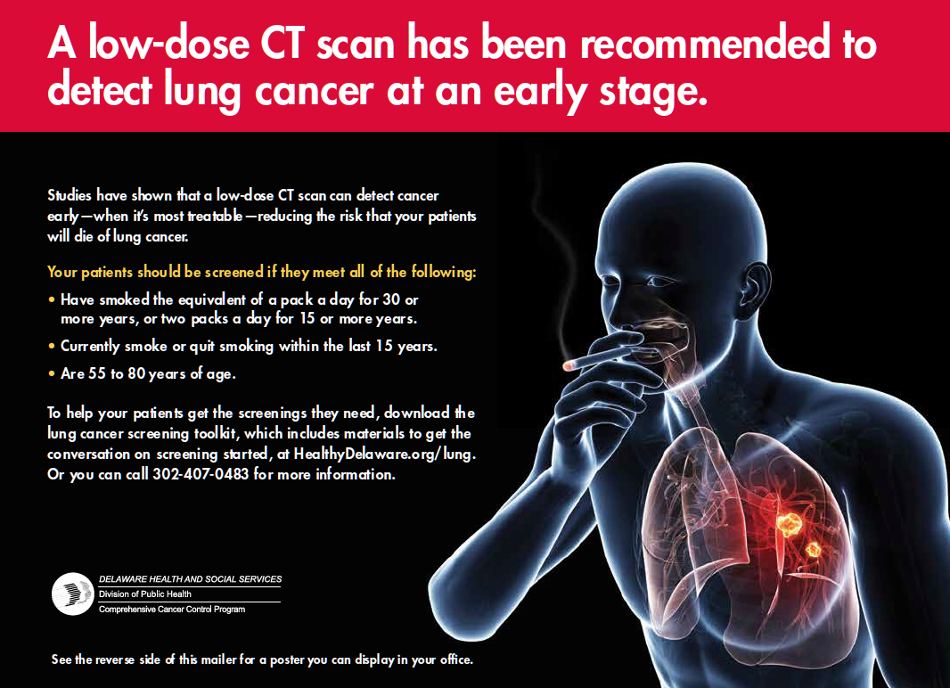

Slide 8

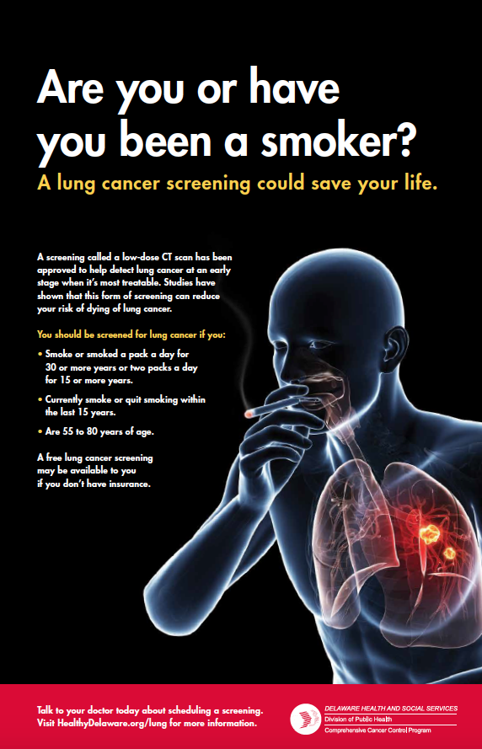

Slide 10
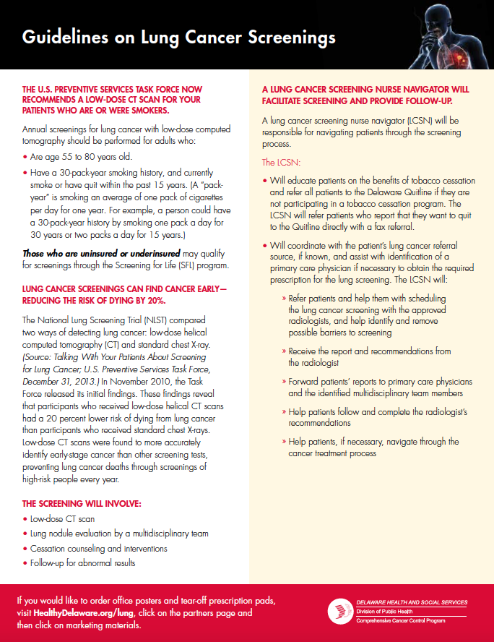

Slide 15
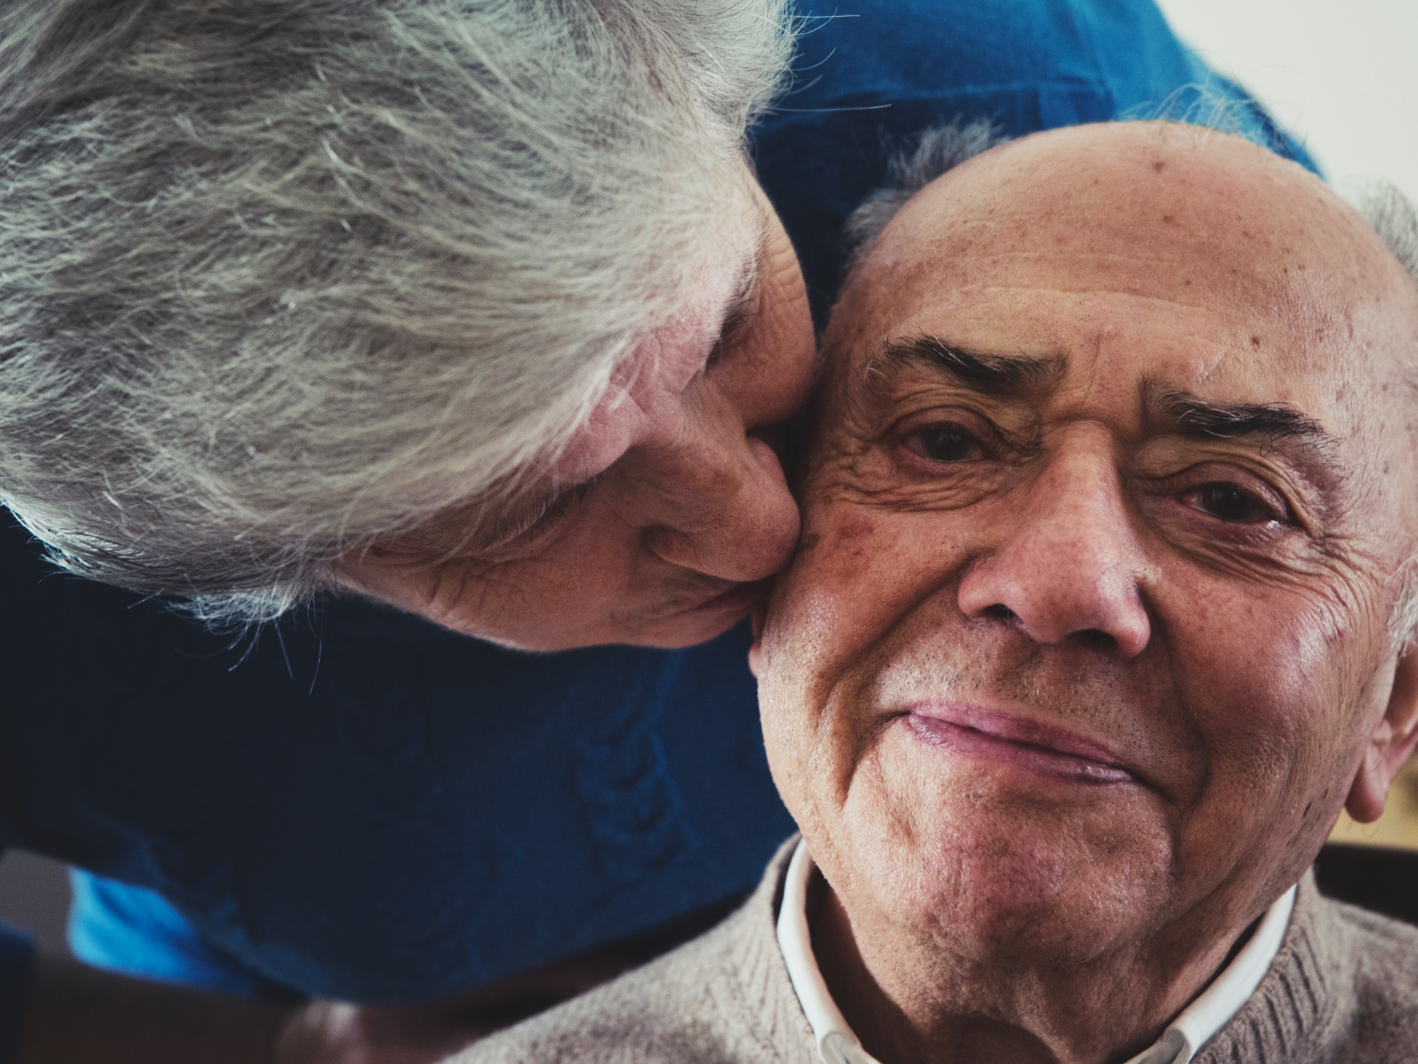
Consumer Campaign Components

Slide 16
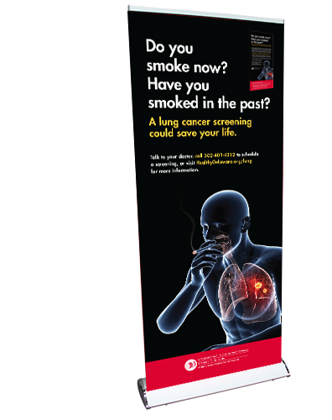

Slide 18
Banner Ad
Banner Ad

Slide 19


Slide 20

HealthyDelaware.org/lung goes live
Campaign targeting Physicians breaks
Consumer collateral materials will be distributed to partner organizations
Campaign targeting Consumers breaks
WEEk of
March
23
Week of
april
6
Week of
april
20
Notes:
Campaign Launch Key Dates:
Week of March 23:
-HealthyDelaware.org/Lung goes live
Week of April 6:
-Campaign targeting Physicians breaks
-Consumer collateral materials will be distributed to partner organizations
Week of April 20:
-Campaign targeting Consumers breaks

